Slide 1






SALES DATA ANALYSIS PRESENTATION

Slide 2
DISCRIPTION ABOUT THE DATA
This project analyzes sales data to understand revenue, product performance, and customer behavior. The dataset includes details like products, prices, and payment methods, helping to gain insights for better business decisions.

Slide 3
PROCESS
These dataset downloaded from the website of Kaggle and imported as a CSV file.in the dataset have 500 rows and 20 columns.
First we check the information about the dataset , regarding their features, datatype and null values.
We check the data cleaning process of checking blank values , duplicates values, and we adding new columns named sales performance and ordered month.
Covert the data into the pivot table format, and Groupby the questions in the pivot table.
analyse the pivot table then create pivot charts and dashboards.

Slide 4
WORKFLOW OF DATA ANALYSIS
UNDERSTANDING DATA AND BUSINESS PROBLEM
NEWLY ADDED COLUMNS
PIVOT TABLE
PIVOT CHART ANALYSIS
PRESENT FINAL INSIGHTS
DATA CLEANING

Slide 5
1.DATA CLEANING PROCESS
Before analysis, data was cleaned by:
Removing missing values
Eliminating duplicate records
Correcting data types
This ensures accurate and reliable results.

Slide 6
1.UNDERSTANDING DATA AND BUSINESS ANALYSIS
defining the main goal ( increase sales, improve customer retention).
Identifying key question to answer.
Understanding business needs and expectations
which product generates highest revenue?
Which region perform best?
And how to improve low sales area?

Slide 7
2.UNDERSTANDING THE DATA AND BUSINESS PROBLEM
defining the main goal ( increase sales, improve customer retention).
Identifying key question to answer.
Understanding business needs and expectations.
which product generates highest revenue?
Which region perform best?
And how to improve low sales area?

Slide 8
3. NEWLY ADDEE COLUMNS:
We added new columns name sales performance and ordered month.
Sales performance, it represents the total revenue generated from sales transactions.it is one of the most important metrics used to evaluate how well the business is performing.
It helps us to , Higher values indicate strong sales and demand, Lower values may highlight issues like low demand or poor marketing, Trends (increase/decrease) help in forecasting future sales
Ordered month, it represents the month in which product or order was placed by the customer.
It helps us to ,we can find which month has highest sales
Detect sales business periods.
Analyze monthly growth trends.

Slide 9
4. PIVOT TABLE ANALYSIS:
A pivot table is used to summarize and analyze data.
Converts raw data into meaningful insights, helps in quick decision making.
Simplifies large data, performs calculations/(sum, average, count), easy comparison of data, saves time and effort.
A pivot table is a powerful tool that turns raw data into useful insights, making analysis faster and easier.

Slide 10
5. PIVOT CHART ANALYSIS:

Slide 11
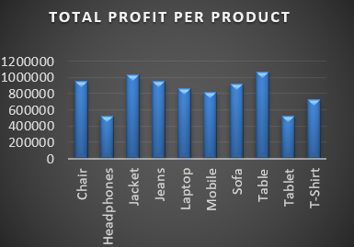
TOTAL PROFIT PER PRODUCT:
This chart represents the total profit generated by each product category. It helps us understands which products are contributing more to the overall business profit.
Table and jacket show the highest profit, indicating strong performance.
Chair, jeans, sofa have moderate profit levels.
Headphones and tablet shows lower profit, indicating weaker performance.
This chart clearly shows profit varies across products, helping business maximize profit and make better decisions.

Slide 12
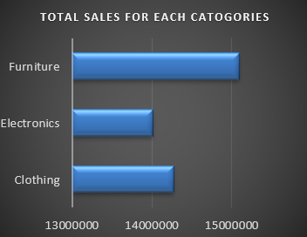
TOTAL SALES FOR EACH CATOGERIES:
This chart shows the total sales generated by each product category. It helps compare overall performance between different categories.
Furniture has the highest sales ( 15,000,000)
, showing strong demand.
Clothing has moderate sales (14,200,000).
Electronics has the lowest sales ( 14,000,000).
This chart helps identify which category contributes most to sales, allowing business to plan strategies and improve overall peformance.

Slide 13
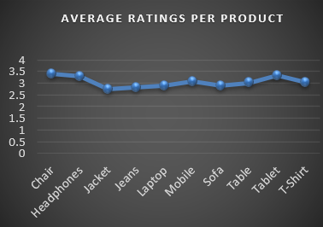
AVERAGE RATING PERPRODUCT :
This chart shows the average customer rating for each product, helping us understand customer satisfaction levels.
Products with higher ratings are well accepted by customers.
Lower rated products may have issues like quality, pricing, or usability.
Overall ratings are around 3 to 3.5, showing moderate satisfaction.

Slide 14
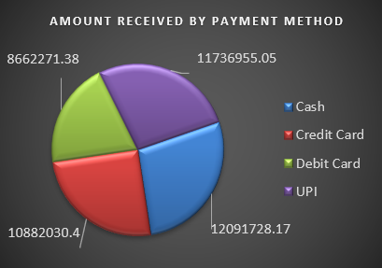
AMOUNT RECEIVED BY PAYMENT METOD :
The pie chart represents the distribution of total revenue received through different payment method
UPI has the highest contribution with ₹11,736,955.05,, making it the most preferred payment method.
Cash follows with ₹12,091,728.17, showing that traditional payment is still widely used.
Credit card payments account for ₹10,882,030.40, indicating moderate usage among customers.
Debit card has the lowest contribution At ₹8,662,271.38 making it the least used option.

Slide 15
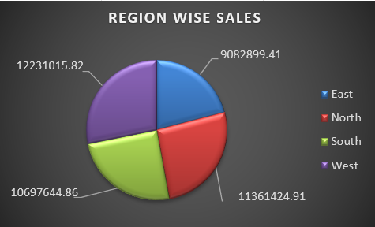
REGION WISE SALES :
This pie chart shows the total sales distribution across different regions: east, north, south, west.
The west and north regions are the major revenue drivers.
The east region needs improvement and may require better marketing or sales strategies.
Business can focus on strengthening weaker regions while maintaining performance in top regions.

Slide 16
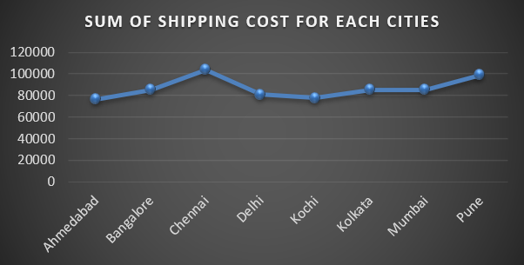
SHIPPING COST FOR EACH CITIES:
This line chart illustrates the total shipping cost incurred across different cities.
Chennai has the highest shipping cost at around ₹105,000, indicating higher logistics expenses.
Pune also shows a high cost close to ₹100,000, making it another expensive city for shipping.
Bangalore, Kolkata, and Mumbai have moderate shipping costs, around ₹85,000–₹90,000.
Ahmedabad, Delhi, and Kochi have relatively lower shipping costs, with Kochi being among the lowest

Slide 17
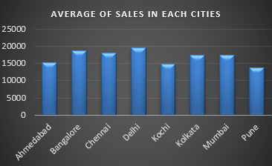
AVERAGE OF SALES IN EACH CITIES:
This Bar chart represents the average sales performance across different cities. Each bar shows how much sales were generated on average specific city.
Major metropolitan cities like Delhi, Bangalore, and Chennai are driving higher sales.
There is an opportunity to improve sales stratergies in lower performing cities like Pune and Kochi.

Slide 18
FINAL INSIGHT :
This sales data analysis project provides clear insights into business performance, customer behavior, and regional trend
Top-performing areas: Cities like Delhi, Bangalore, and Chennai and regions like North and West are the main revenue drivers.
Product performance: Products such as Tables and Jackets generate higher profit, while items like Headphones and Tablets need improvement.
Category analysis: Furniture leads in total sales, followed by Clothing and Electronics
Customer behavior: Most customers prefer UPI and Cash payments, showing a mix of digital and traditional payment trends.
Operational insight: Cities like Chennai and Pune have higher shipping costs, which may impact profit margins.
Growth opportunities: Lower-performing cities like Pune and Kochi and weaker regions (East) need better marketing, pricing strategies, and customer engagement.

